Slide 1
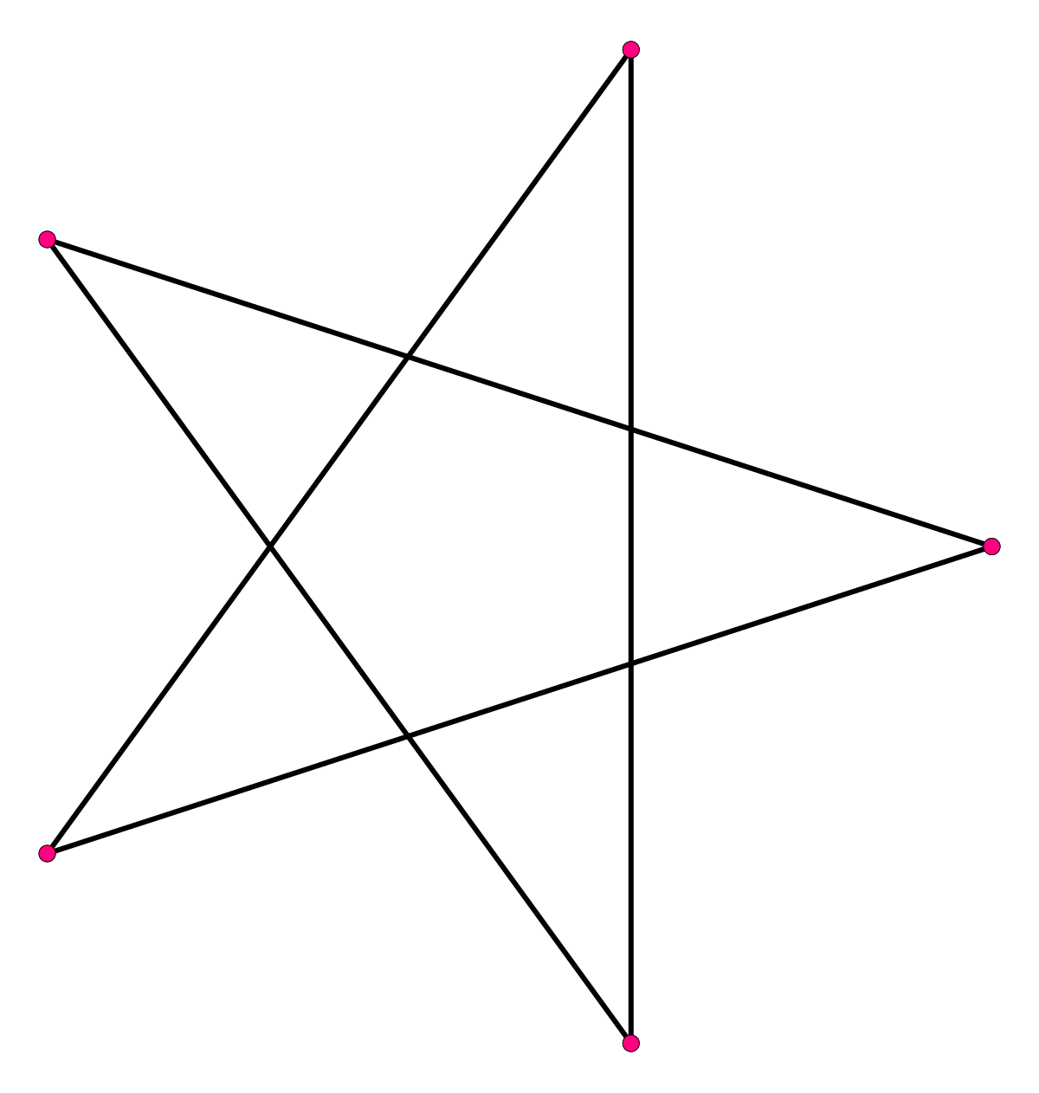
O’Rielly Architecture Katas Autumn 2021
Buland Malik
Haidar Hadi
Farmacy Family System Architecture & Design
Ajay Sreehari
Munir Mastalic
Somenath Mukherjee
Pentagram2021

Slide 2
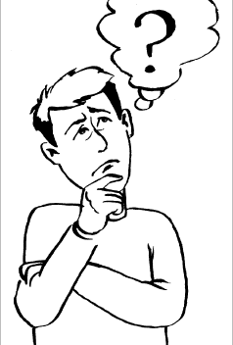
Problem Statement
Wow, Food as medicine. Bob has been using awesome & delicious food to overcome his health issues with obesity and high blood pressure. He feels lucky that he found this great platform known as Farmacy Food whose slogan is Food As Medicine. He has been sharing this idea widely within his circles and looking more better ways and means to become an engaged customer where he can be the voice of the the great initiative, connect with other similar minded people as well as areas where he can improve to address his struggles with his medical conditions.

Slide 3
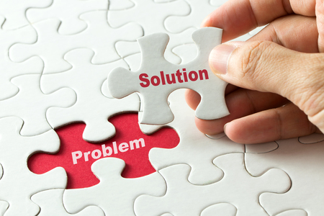
Solution
We have been thinking about the extension of Farmacy Food as well as heard our customers and we are happy to share that we have started our efforts towards that. The overall idea is to make sure we provide a platform to our huge customer base where they can better engage themselves, be the voice of the program, educate themselves via different wellness programs offered through this new platform, easily able to engage with medical providers to get better insights about how their overall health is doing and rely on the platform for better suggestions to improve their health using food as medicine and platform making sure that right food is available in right areas considering all the analytics results which is all based on difference set of customer data.
Farmacy Family

Slide 4
Architecture Characteristics & Style
Notes:
How do we satisfy these customers? We begin the architectural analysis.

Slide 5
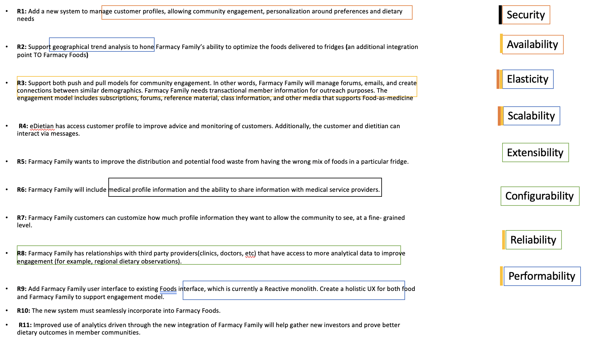
Quality Attributes/ Architecture Ilities / Characteristics
Notes:
How do we satisfy these customers? We begin the architectural analysis.

Slide 6
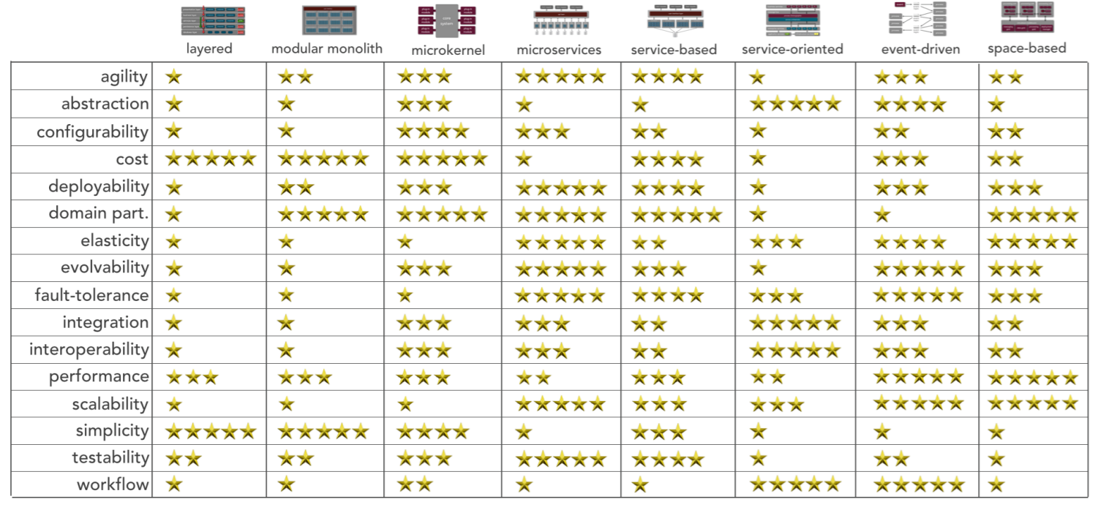
Architecture Styles
Service-based Architecture Style
Decision is to use
Event-Driven

Slide 7
System Design
Notes:
How do we satisfy these customers? We begin the architectural analysis.

Slide 8
Step 1: Component Identification
Using Workflow Approach (Event Storming DDD Concept) - Actor/Action Approach
Customer
Signup to become Engage Customers (Provide Profile Info)
Configure Preferences
Customer Info Community can see
Can be shared with medical service providers
Create Forums
Engage in Social events (classes, forums, wellness education programs)
Engage with doctors & Dieticians
Dieticians
Access Customer Profile
Update Customer Profile
Engage with Customers
System
Integrate with Clinics
Integrate with eDieticians
Integrate with Farmacy Food
Integrate with Generic Components (Notifications, Reports etc.)
Gather Customer results and store it in Data Lake via Ingestion process
Payments/Procurements???
Analytics
Gather results from data lake and run ML Models
Store Customer/Geographical suggestions/trends suggested by ML

Slide 9
Step 2 & 3: Assign Requirements to Components
Customer
Customer Profile Capture
Preferences Capture
Wellness Engagement Models
Medical Engagement models
Medical Providers
Gather Results
Analyze Results
Give Suggestions/Advise
Dieticians
Access Customer Profile
Update Customer Profile
Engage with Customers
System
Advertisement (Generating Leads for Email Notification)
Integration with Clinics
Integration with eDieticians
Integration with Farmacy Food
Integration with Generic Components (Notifications etc.)
Payments/Procurements???
Store customer data in the Data Lake via Ingestion process
Payments/Procurements???
Analytics
Gather results from data lake and run run ML Models
Store Customer/Geographical suggestions/trends suggested by ML
R1
R2
R3
R4
R5
R6
R7
R8
R9
R10
R11

Slide 10
Strategic Design
Supportive
Core
Uniqueness
Email/Text Messaging
Scheduling
Customer
Analytics
Advertisement
Customer Engagement
CMS
Notification
System Engagement
Medical System
Generic
AuthN & AuthZ
Complexity

Slide 11
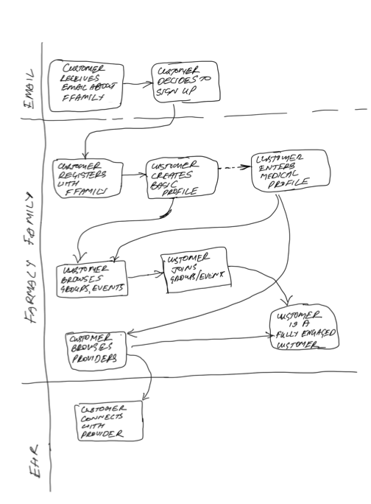
User Journey

Slide 12
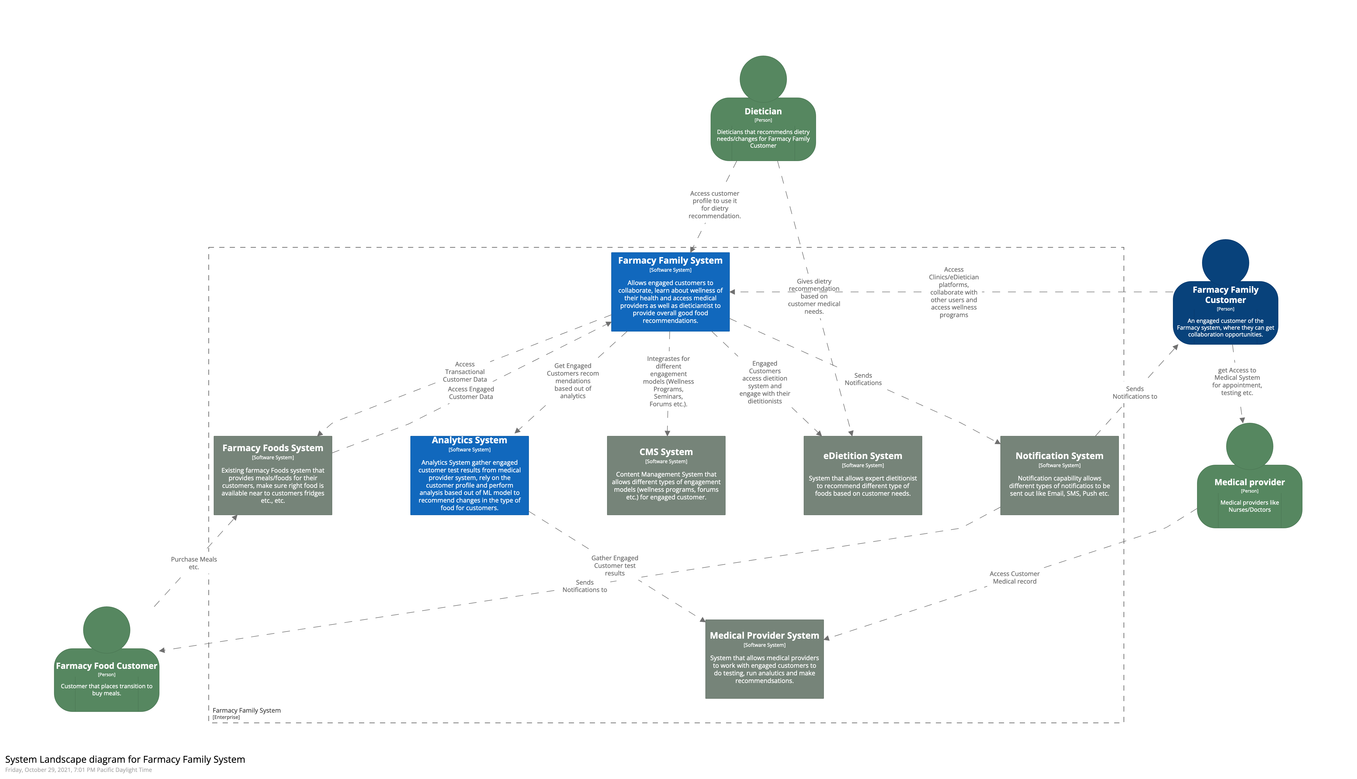
System Landscape Diagram

Slide 13
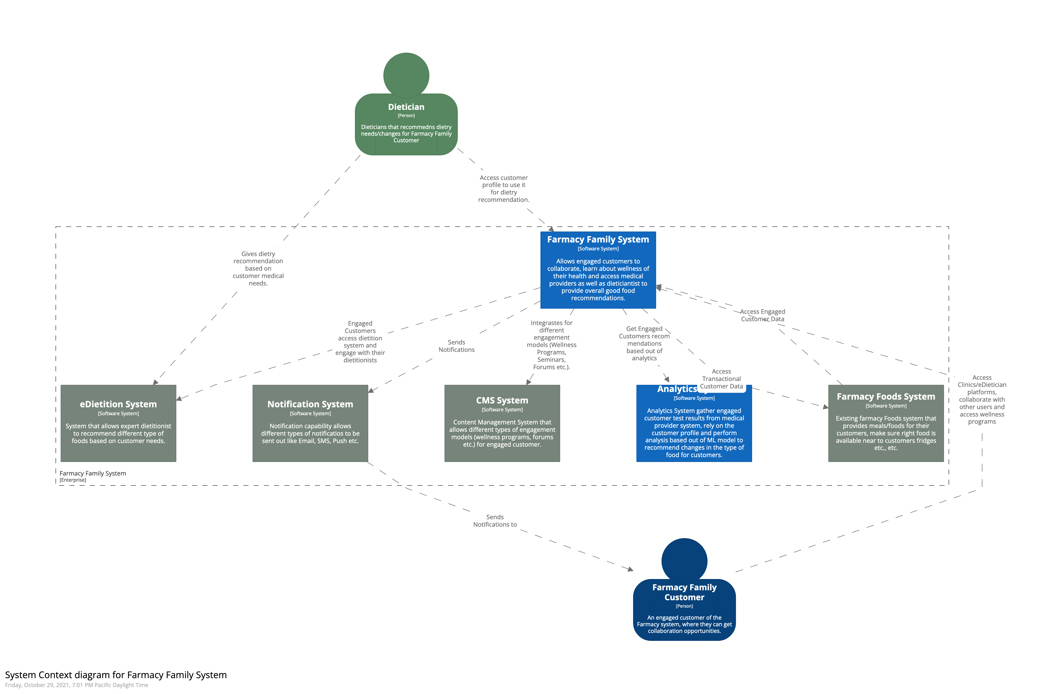
Context Diagram

Slide 14
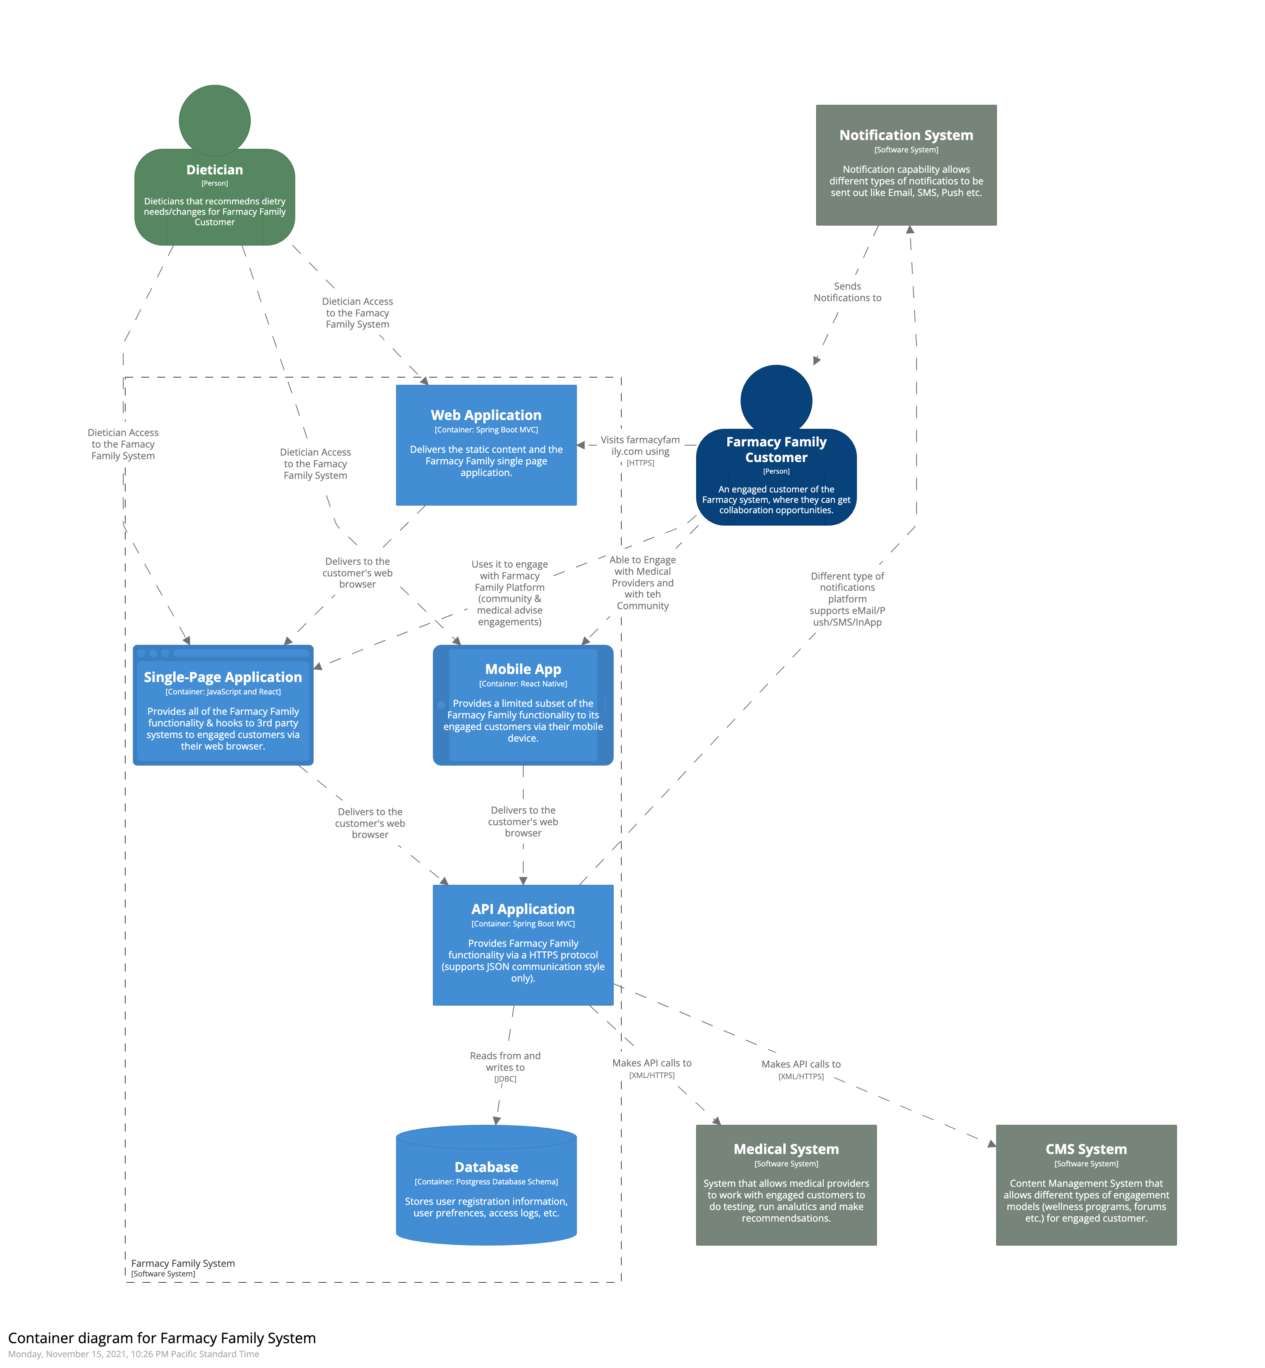
Farmacy Family Container Diagram

Slide 15
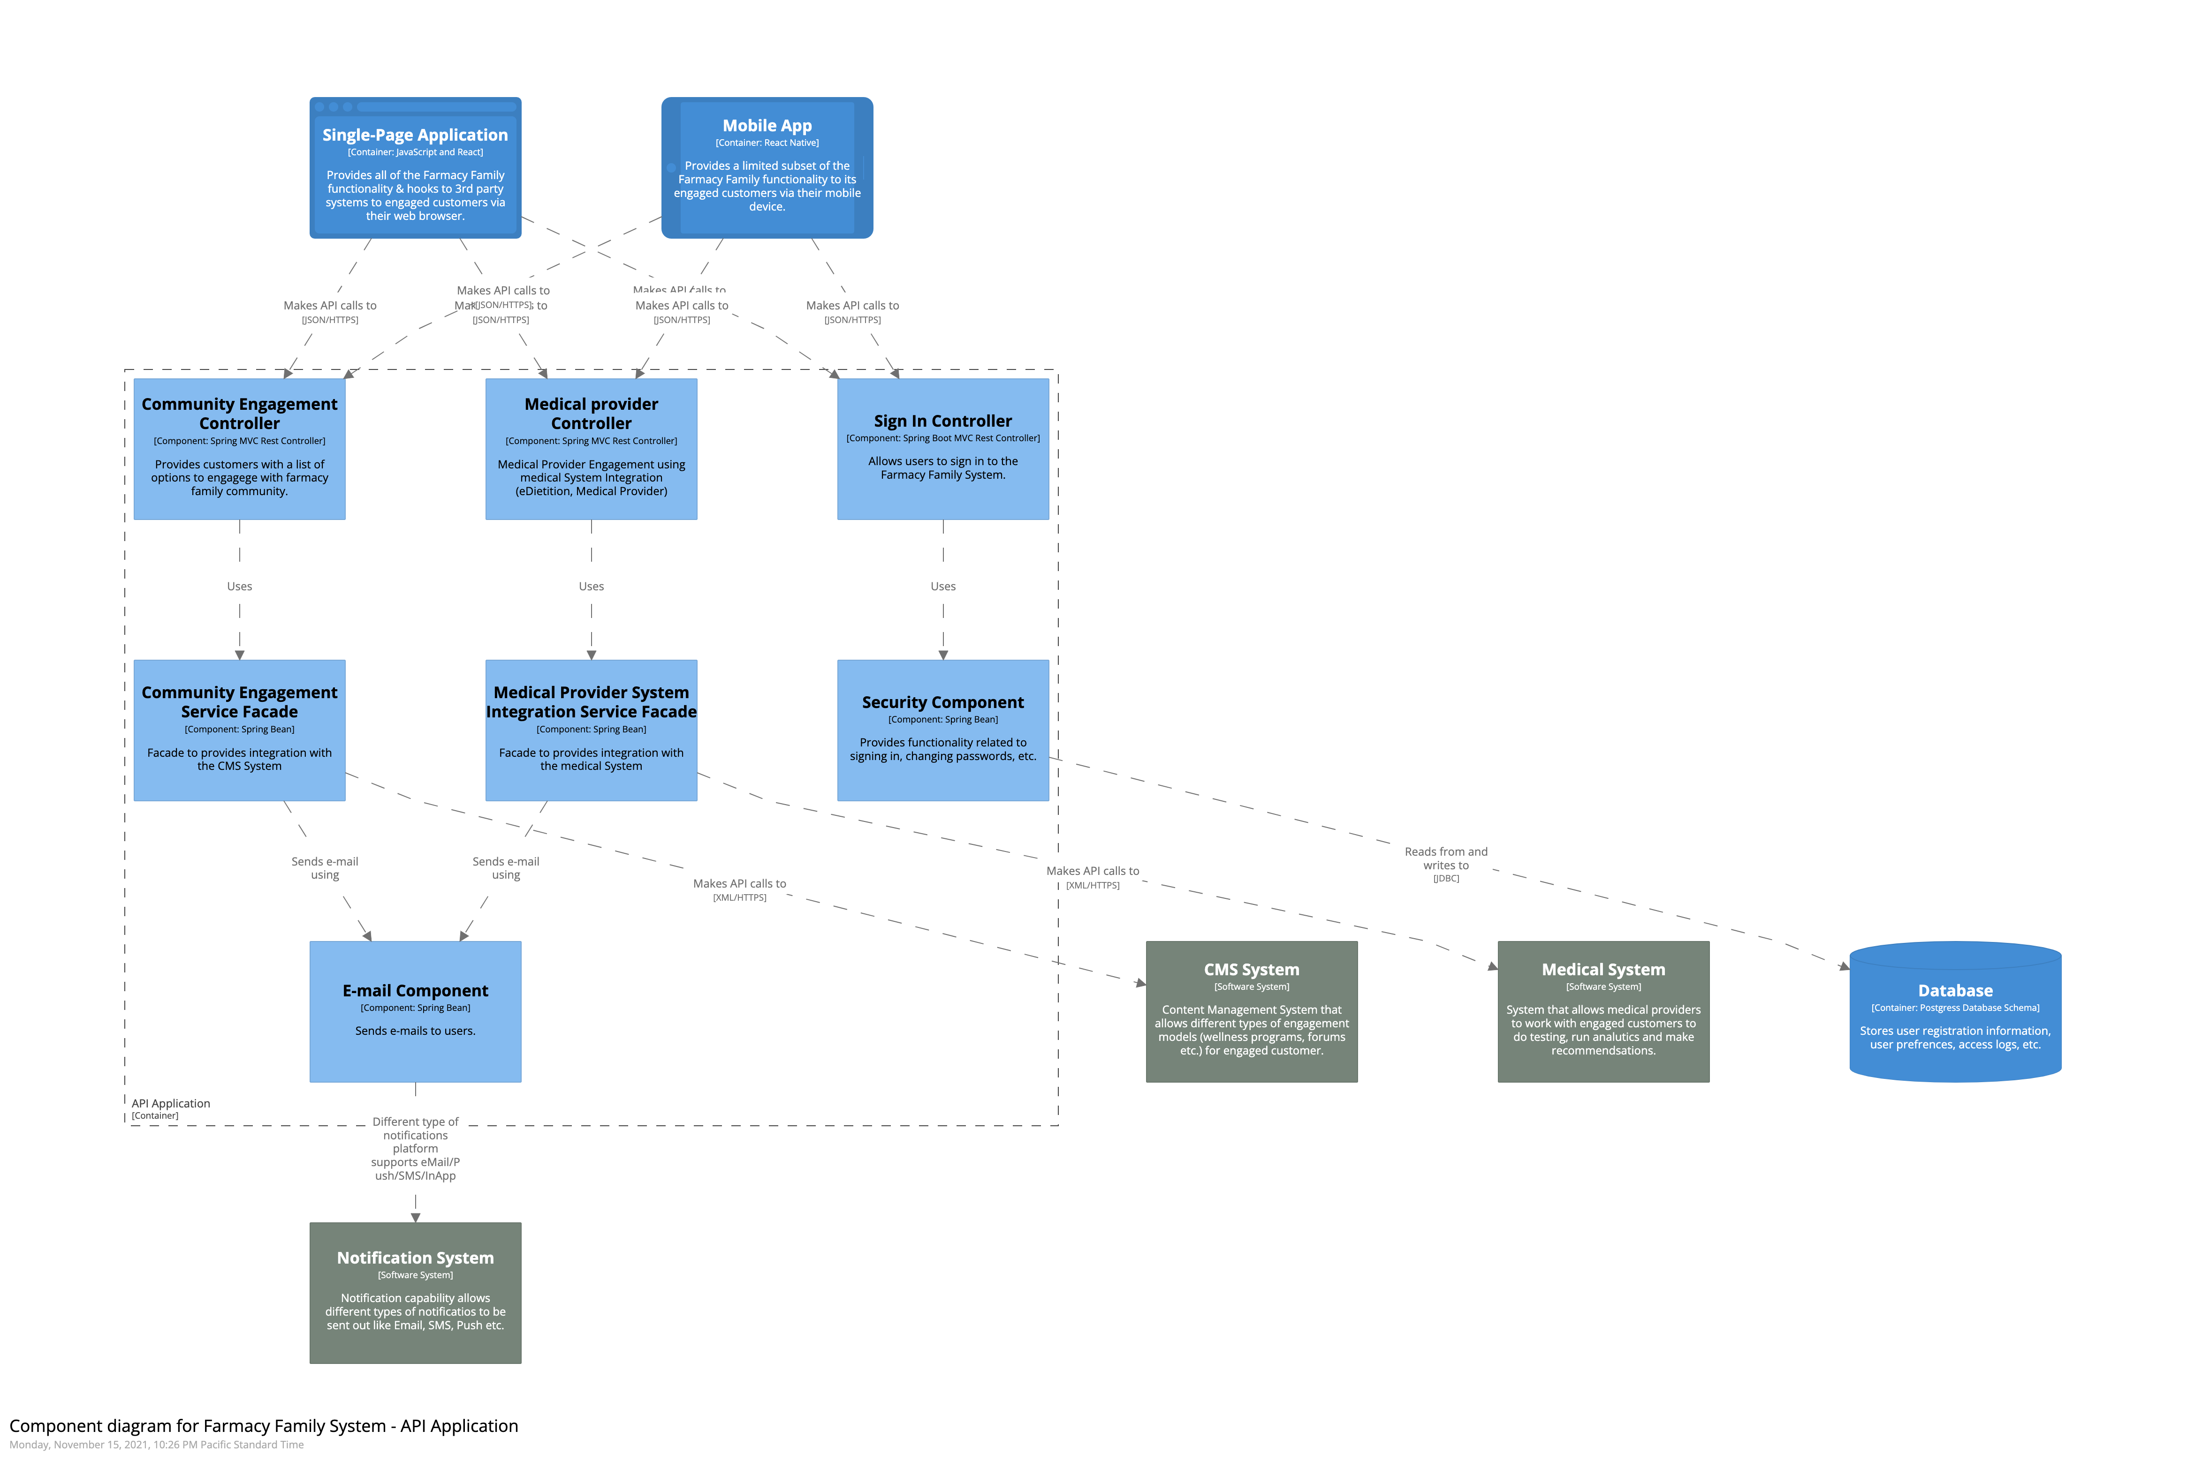
Farmacy Family Component Diagram

Slide 16
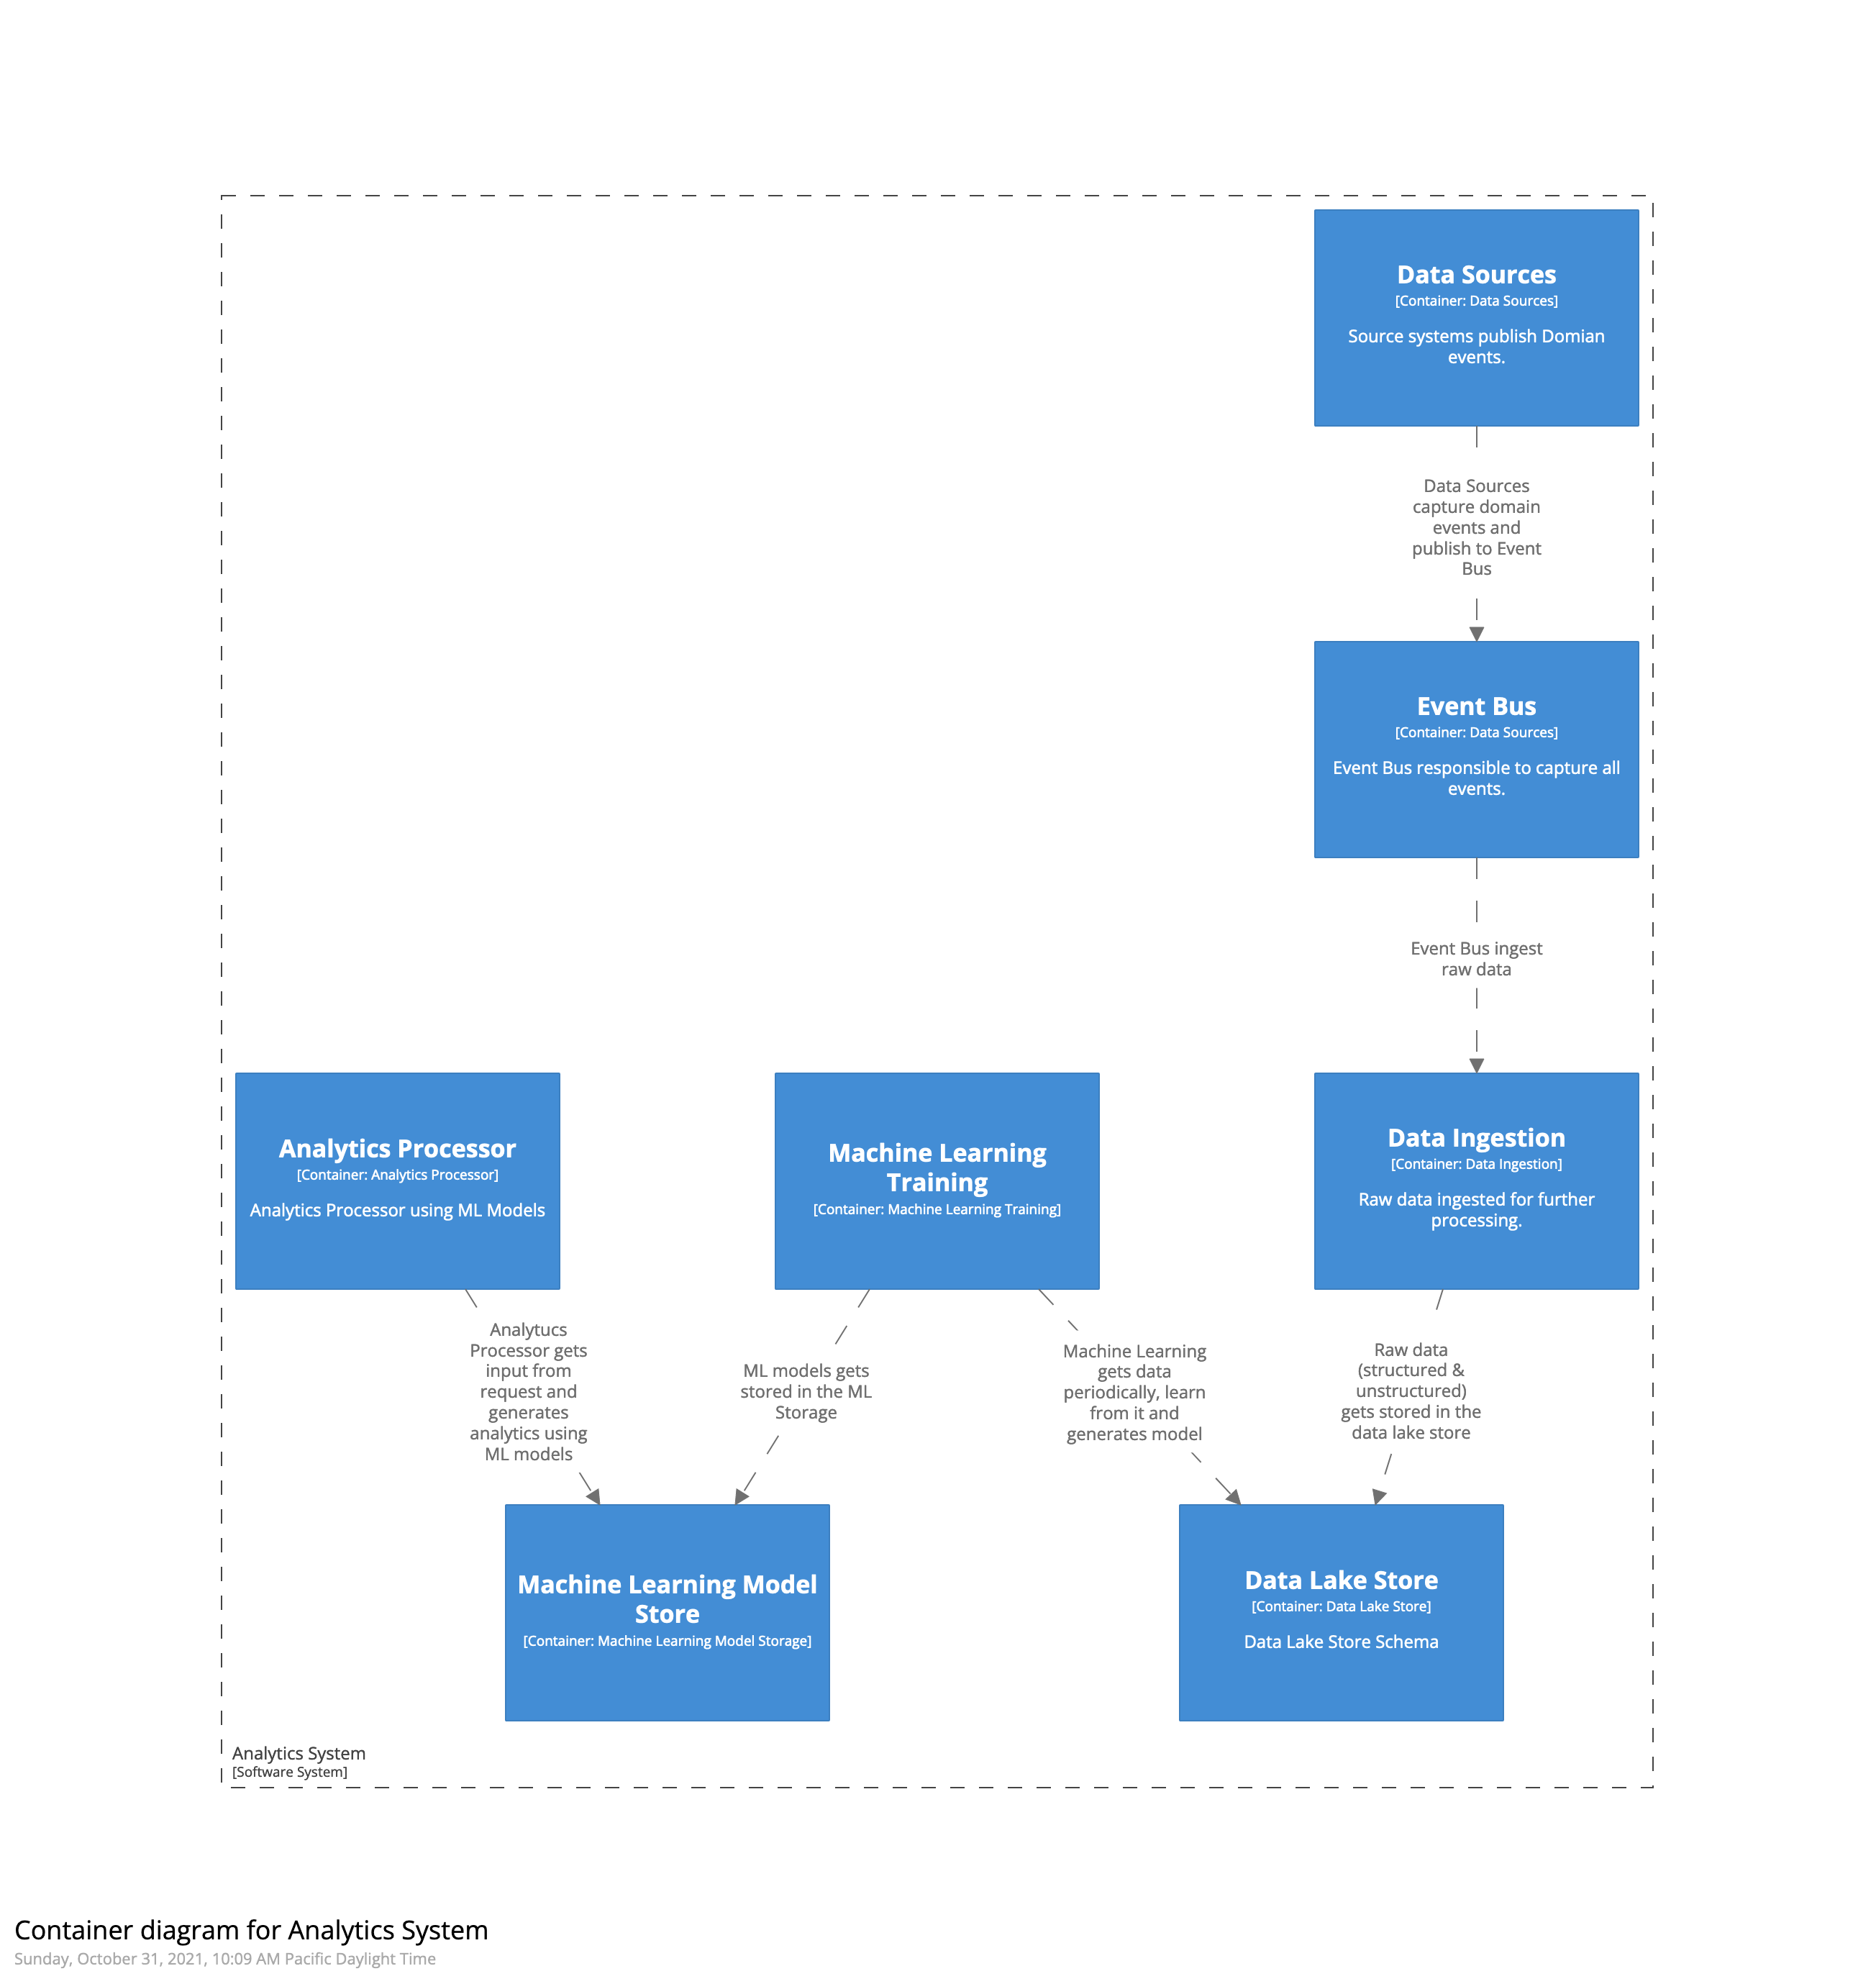
Analytics Container Diagram

Slide 17
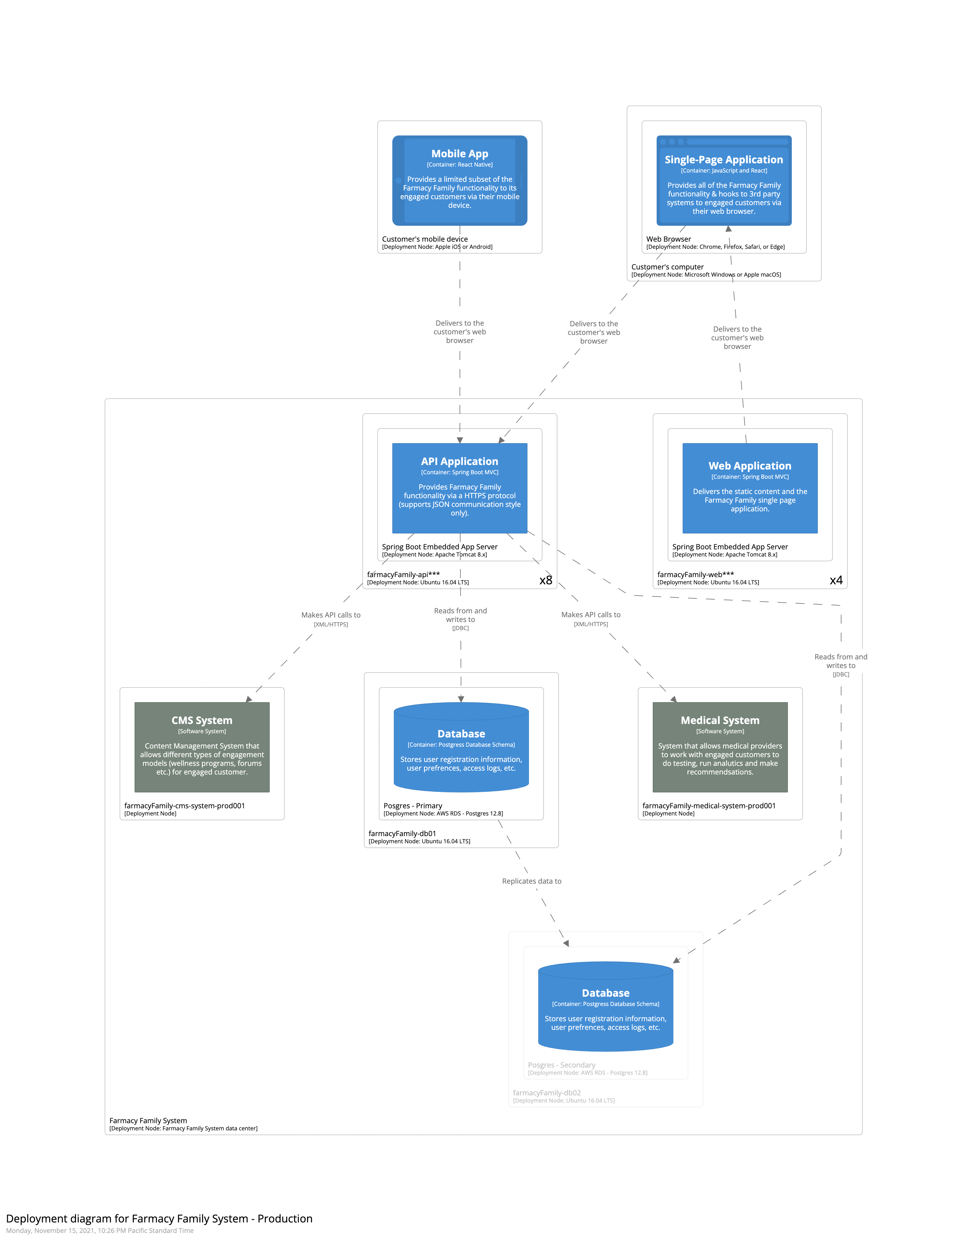
Farmacy Family Deployment Diagram

Slide 18
Key Links
Farmacy Family artefacts root folder
What went into consideration?
Requirements
Quality Attributes Identification
ADRs
Overall Solution

Slide 19

Thank You!

